Slide 1

UART
Universal Asynchronous Receiver /Transmitter
on
ZedBoard
By
Aashraye Saraf - 22001003006
Aishani Sinha - 22001002004

Slide 2
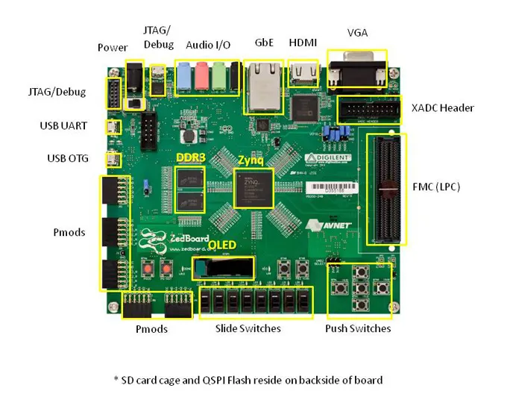
Zedbaord

Slide 3
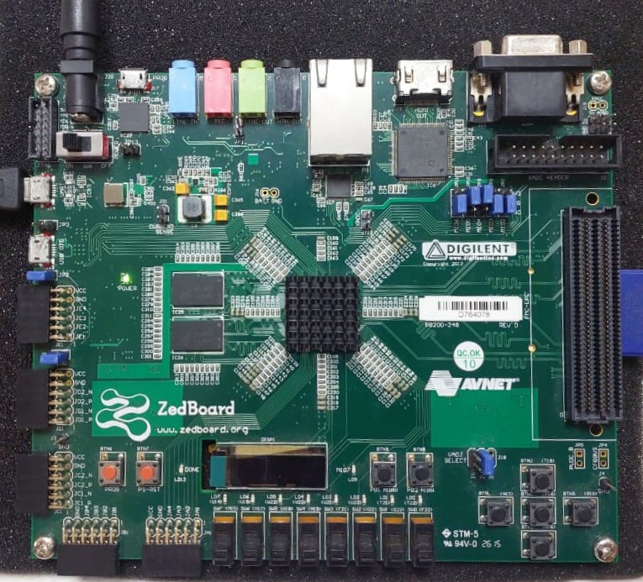
Zedbaord

Slide 4
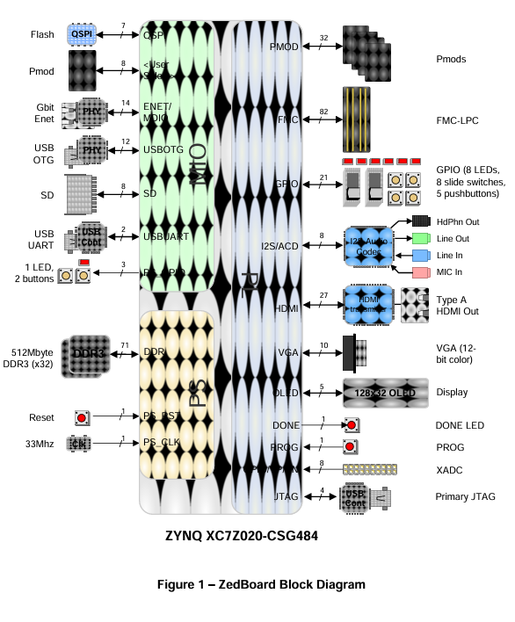
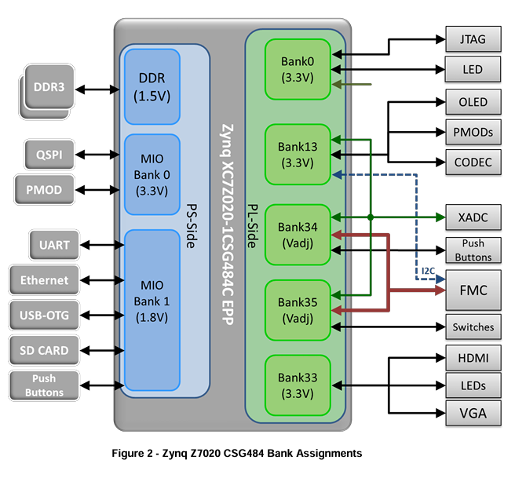
Zedbaord Datasheet

Slide 5
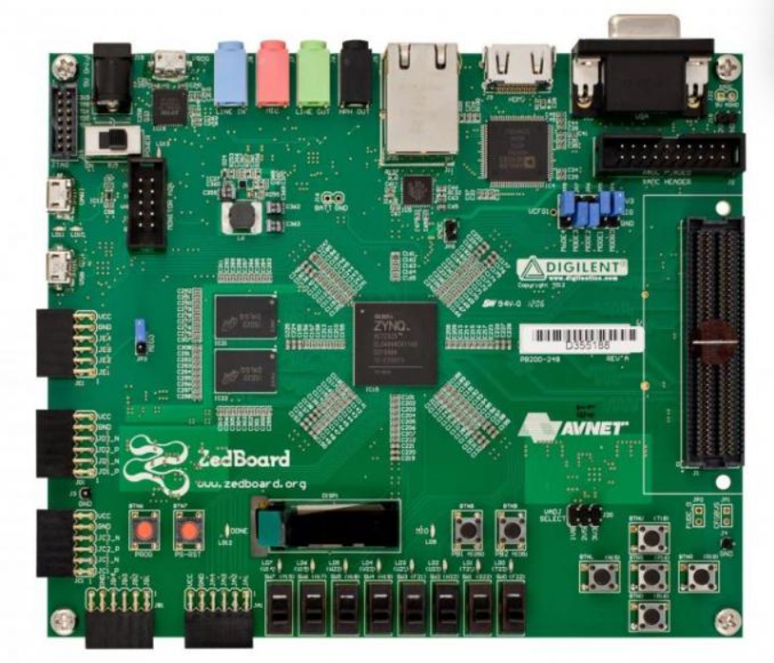
ZedBoard Hardware Components Relevant to UART Implementation
Overview of ZedBoard and Zynq-7000 Architecture
ZedBoard is built around the Xilinx Zynq-7000 SoC, which integrates a dual-core ARM Cortex-A9 processor (Processing System, PS) with programmable logic (PL), allowing for flexible hardware/software co-design.
The PS handles software tasks, while the PL is used for custom hardware implementations, such as UART peripherals.

Slide 6
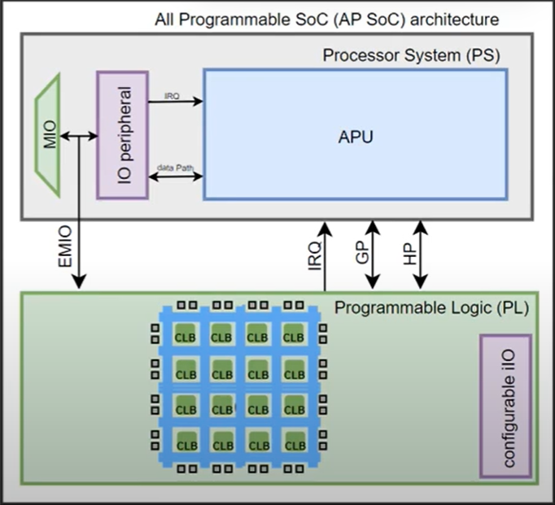
Key Hardware Components for UART Protocol
Processing System (PS):
Contains the ARM Cortex-A9 CPU, memory management unit, L1 and L2 caches, timers, and system control units.
Manages communication with peripherals and is responsible for running software drivers for UART.
Programmable Logic (PL):
Functions as an FPGA, enabling the implementation of custom UART logic or additional UART modules when needed.
Facilitates hardware acceleration and flexible peripheral integration.

Slide 7
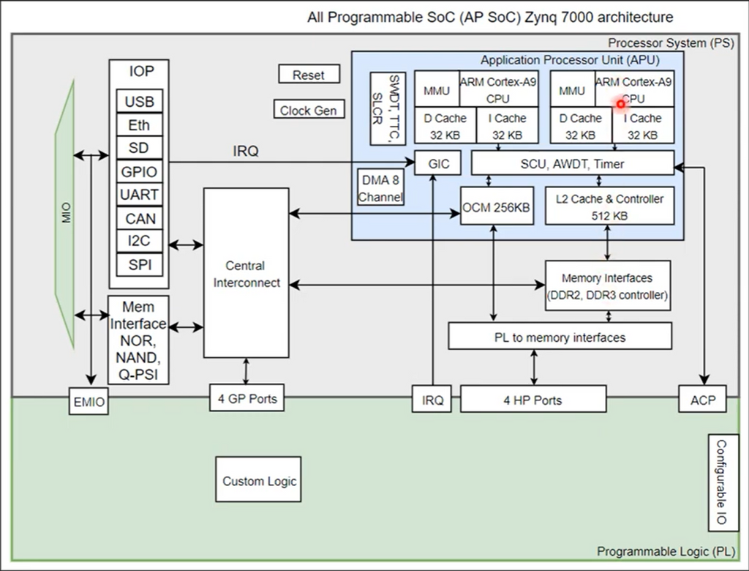
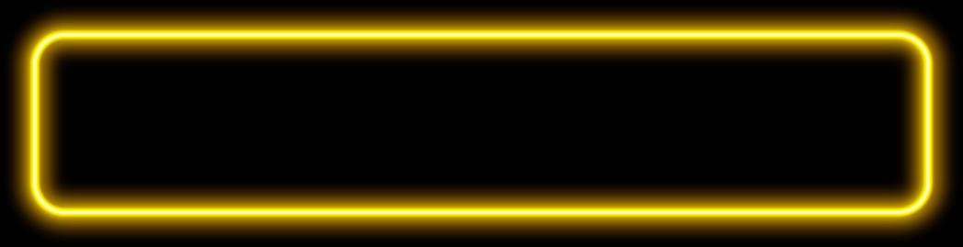

Key Hardware Components for UART Protocol
Peripheral Interfaces:
The ZedBoard provides multiple peripheral interfaces, including UART, USB, Ethernet, SD, GPIO, I2C, and SPI.
UART interfaces can be accessed through the Multiplexed I/O (MIO) pins, which are dynamically allocated for different peripherals.
Memory Interfaces:
Supports both external DDR RAM (for general data storage) and on-chip RAM (OCM) for low-latency applications, which can be crucial for high-speed UART data buffering.

Slide 8

Key Hardware Components for UART Protocol
Direct Memory Access (DMA): DMA controllers allow efficient data transfer between memory and UART peripherals without burdening the CPU, improving overall system performance.
Interrupt Controller (GIC): Handles interrupts from UART and other peripherals, ensuring timely processing of incoming and outgoing serial data.

Slide 9
Integration and Communication
PS-PL Communication:
Multiple AXI-based interfaces (General, High-Performance, and Accelerator Coherency Ports) enable fast and flexible data exchange between the PS and PL.
This is essential for applications where custom UART logic in the PL must interact with software running on the PS.
Peripheral Pin Mapping:
The ZedBoard’s 54 MIO pins allow for flexible mapping of UART signals to external connectors, supporting various UART configurations.

Slide 10
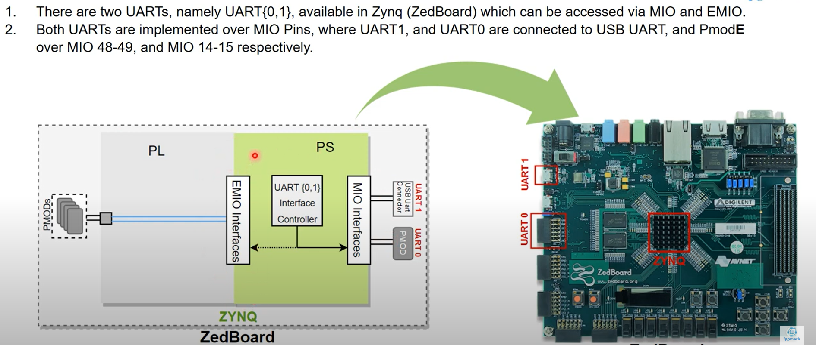
Implementation of UART modules (UART0 and UART1) on the ZedBoard

Slide 11
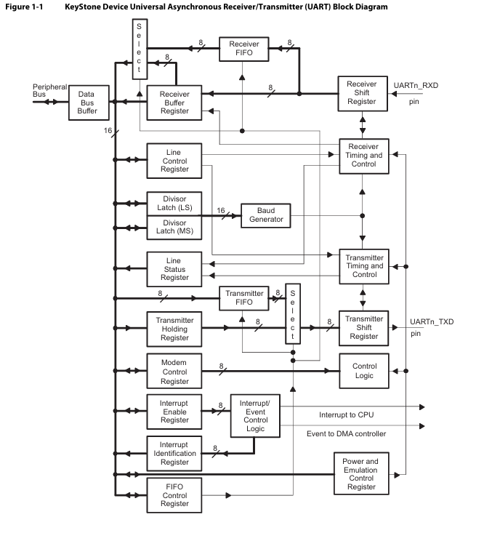
UART
Universal Asynchronous Receiver/Transmitter
The UART performs serial-to-parallel conversions on data received from a peripheral device and parallel-to-serial conversion on data received from the CPU. The CPU can read the UART status at any time. The UART includes control capability and a processor interrupt system that can be tailored to minimize software management of the communications link.
The UART includes a programmable baud generator capable of dividing the UART input clock by divisors from 1 to 65535 and producing a 16× reference clock or a 13× reference clock for the internal transmitter and receiver logic. For detailed timing and electrical specifications for the UART, see the device-specific data manual.

Slide 12
UART
Universal Asynchronous Receiver/Transmitter
The UART performs serial-to-parallel conversions on data received from a peripheral device and parallel-to-serial conversion on data received from the CPU. The CPU can read the UART status at any time. The UART includes control capability and a processor interrupt system that can be tailored to minimize software management of the communications link.
The UART includes a programmable baud generator capable of dividing the UART input clock by divisors from 1 to 65535 and producing a 16× reference clock or a 13× reference clock for the internal transmitter and receiver logic. For detailed timing and electrical specifications for the UART, see the device-specific data manual.

Slide 13
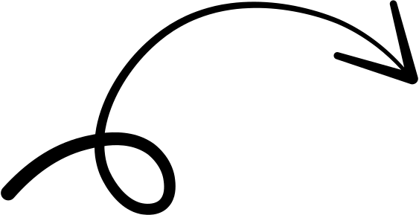
UART
Universal Asynchronous Receiver/Transmitter
Transmitter

Slide 14
UART
Universal Asynchronous Receiver/Transmitter
Receiver

Slide 15
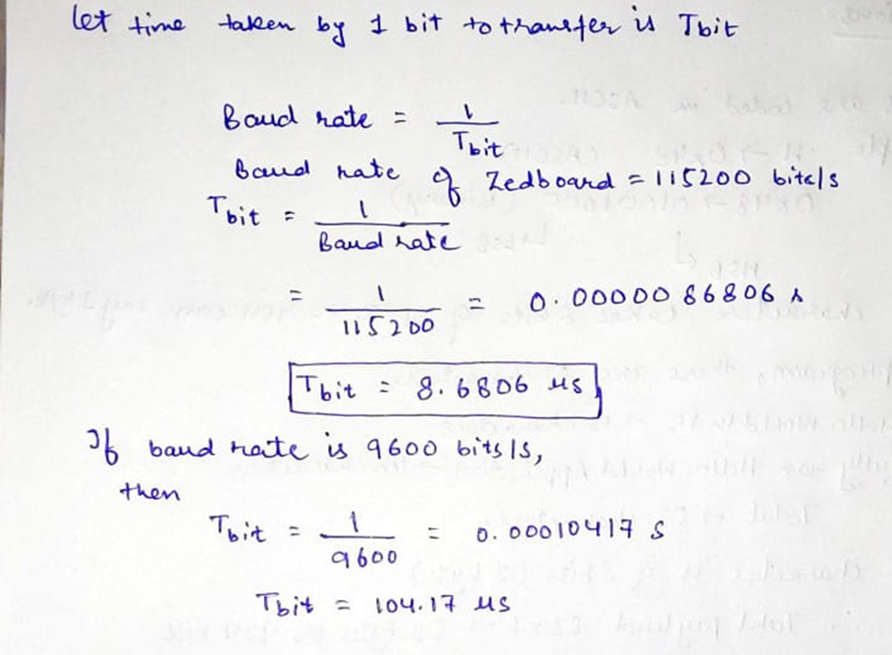
UART
Universal Asynchronous Receiver/Transmitter
Baud Rate
Baud rate is no of bits transferred per second.
Example of Baud rates: 110 (very old systems), 9600 bps (very common default), 115200 bps (common in debugging, microcontrollers), 921600 bps (some high-speed UARTs).

Slide 16
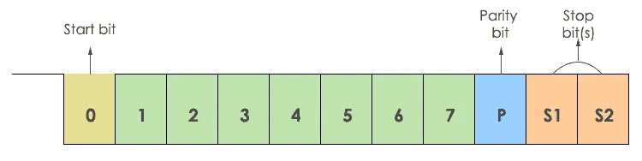
UART
Universal Asynchronous Receiver/Transmitter
UART Frame Format
UART Data Format Examples
8N1 (most common)
1 start + 8 data + no parity + 1 stop = 10 bits per character
7E1
1 start + 7 data + even parity + 1 stop = 9 bits per character
8O2
1 start + 8 data + odd parity + 2 stop = 12 bits per character

Slide 17
UART
Universal Asynchronous Receiver/Transmitter
UART Frame Format
Start Bit
In UART communication, each data frame starts with a single start bit. The start bit is always logic low (0), indicating the beginning of data transmission. This low signal alerts the receiver to prepare for incoming data. Once the receiver detects the start bit, it begins timing the reception of the following bits in the frame.
Data Bit
Data bits carry the actual information being transmitted. While the most common configuration is 8 data bits, UART also supports other sizes like 7 or 6 bits, depending on the application’s needs.
Parity Bit
It’s an error-checking feature added to the data frame. It helps detect transmission errors by ensuring the total number of bits set to logic "1" is either even or odd, based on the selected parity type. If the received data doesn’t match the expected parity, the receiver flags it as an error, indicating possible data corruption. If even parity is used, the total number of 1s in the data (including the parity bit) must be even. If odd parity is used, the total must be odd.
Stop Bit
Stop bit(s) are sent after the data bits to indicate the end of a data frame. The most common setup uses one stop bit, but two stop bits can be used for added reliability. Stop bits are usually at logic high (1), though their polarity may vary depending on the system’s configuration.

Slide 18
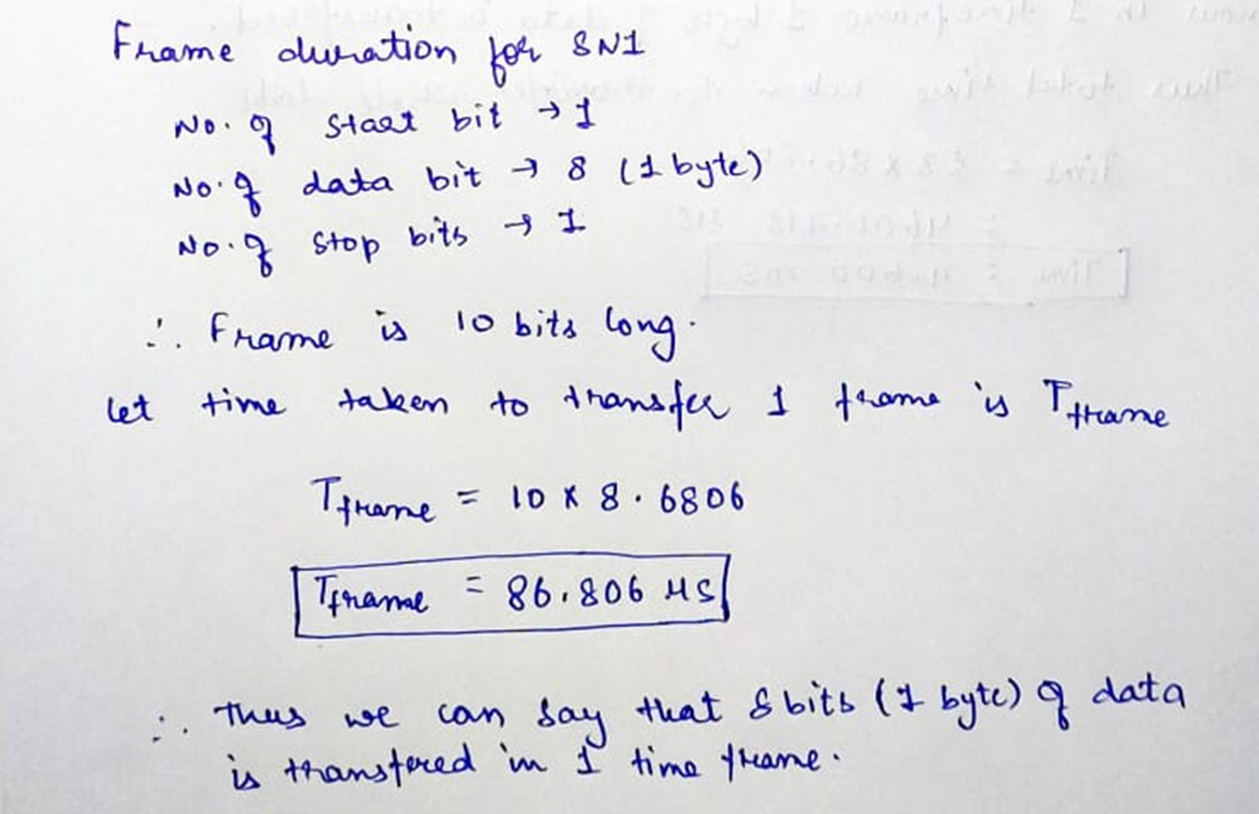
UART
Universal Asynchronous Receiver/Transmitter
Frame Duration

Slide 19
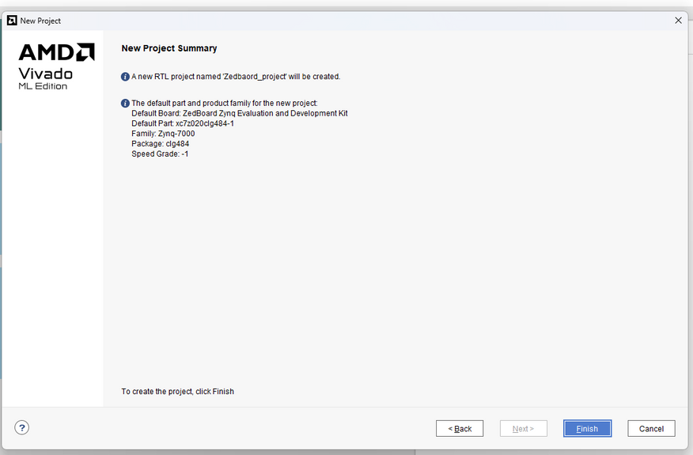
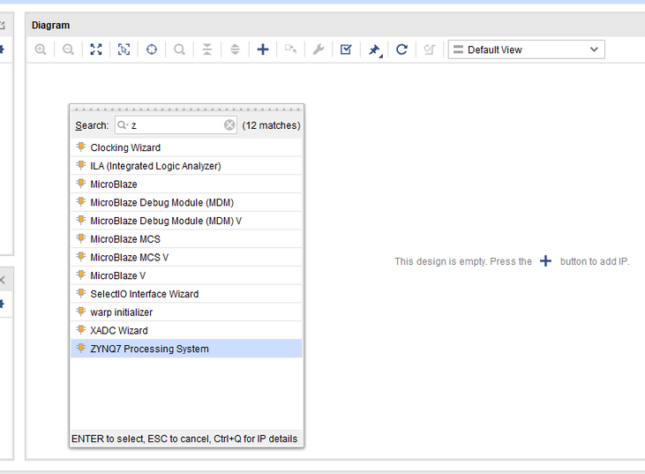
Developed the UART module's frontend using Vivado
1. Create a New Vivado Project
Launch Vivado and start a new project.
Select the appropriate board (ZedBoard with Zynq-7000 SoC).
Complete the project setup by clicking through the wizard.
2. Create a Block Diagram
Inside the project, create a new block diagram.
Add the Zynq7 Processing System (PS) block to the diagram.

Slide 20
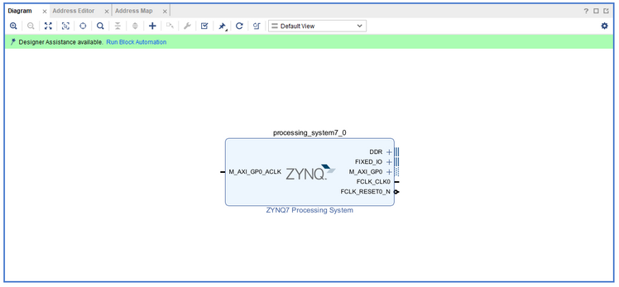
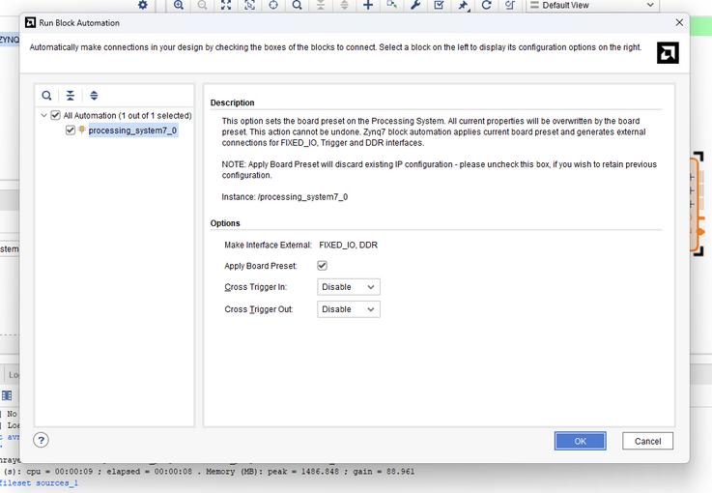
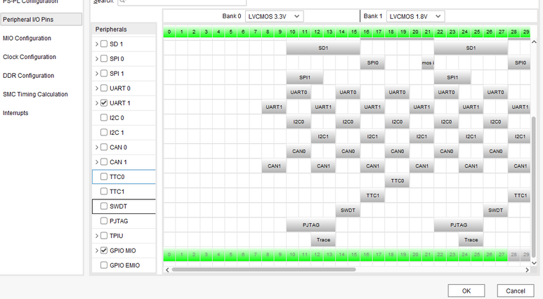
Developed the UART module's frontend using Vivado
3.Run Block Automation
Click on “Run Block Automation” for the Zynq7 PS block.
Let Vivado automatically configure the basic settings for the processing system.
4. Configure UART Interfaces via MIO
Double-click the Zynq7 PS block to open its configuration window.
In the “MIO Configuration” section, enable UART0 and UART1.
Map UART1 to MIO pins 48 and 49 (connected to USB-UART).
Map UART0 to MIO pins 14 and 15 (connected to Pmod port).
Optionally, enable pull-up resistors on the UART pins to ensure stable signal levels.

Slide 21
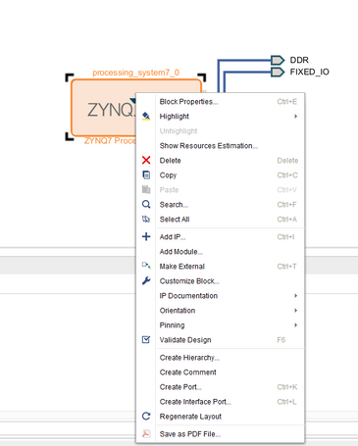
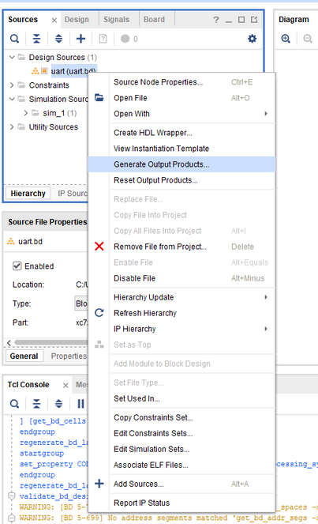
Developed the UART module's frontend using Vivado
5.Disconnect Unused Peripherals
In the PS-PL (Processing System–Programmable Logic) configuration, disconnect unused peripherals and clocks to simplify the design if you are only using UART.
6. Validate the Design
Click “Validate Design” to check for errors or warnings.
Ensure the design is free of critical issues before proceeding.
7. Generate Output Products
Right-click on the block diagram and select “Generate Output Products.”
Wait for Vivado to generate all necessary files for the design.

Slide 22
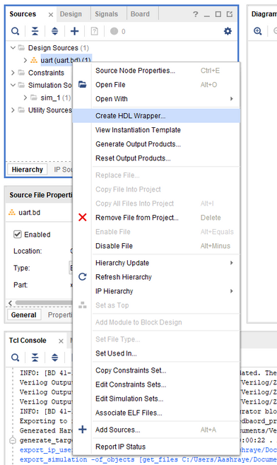
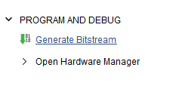
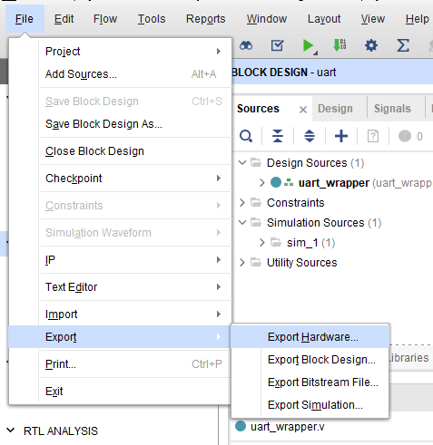
Developed the UART module's frontend using Vivado
Create HDL Wrapper
Right-click on the design (e.g., design_1) and select “Create HDL Wrapper.”
Allow Vivado to manage the wrapper automatically.
9. Generate the Bitstream in Program and Debug
10. Export Hardware
Go to the “File” menu and select “Export > Export Hardware.”
Choose to export the hardware including a bitstream.
This step prepares the hardware description for use in the Xilinx SDK.

Slide 23
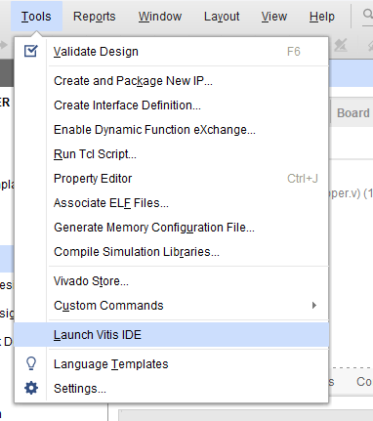
Developed the UART module's frontend using Vivado
10. Launch Vitis and Develop Application
Launch the Xilinx Vitis from Vivado.
Import the exported hardware platform.
Create a new application project (e.g., a UART test application).
Develop and load C code to initialize UART, send, and receive data using the provided driver files.

Slide 24
Environment Setup and Vitis(24.1) Launch
Set up your development environment by installing Vivado 2024.1 and Vitis 2024.1.
Configure your system by sourcing the necessary environment scripts (settings64.sh), ensuring your system paths include Vivado and Vitis tools.
Launch the Vitis IDE, specify a workspace directory, and prepare for project creation.

Slide 25
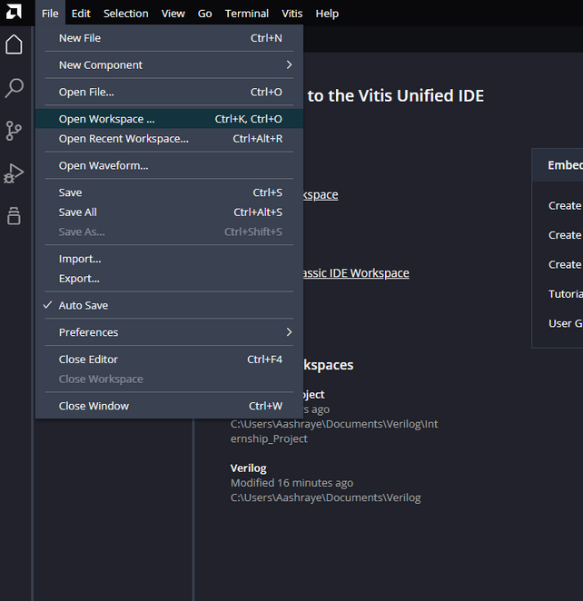
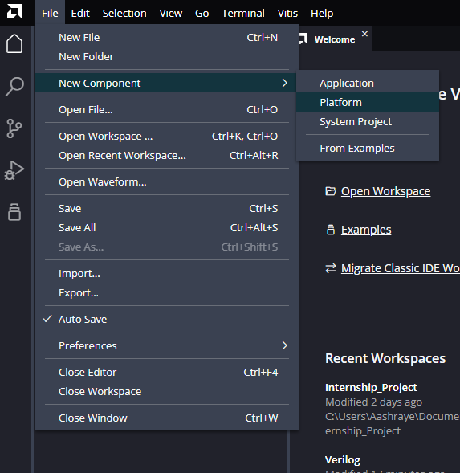
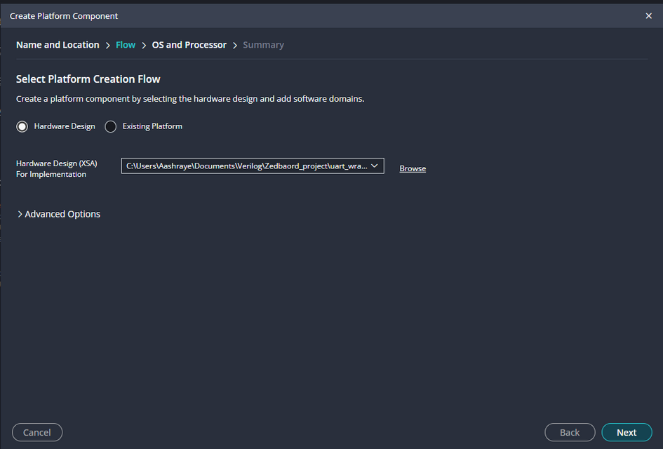
Hardware Platform Preparation
Select a workplace first.
The create a new platform on it. Make sure to select the .xsa file when choosing the platform.

Slide 26
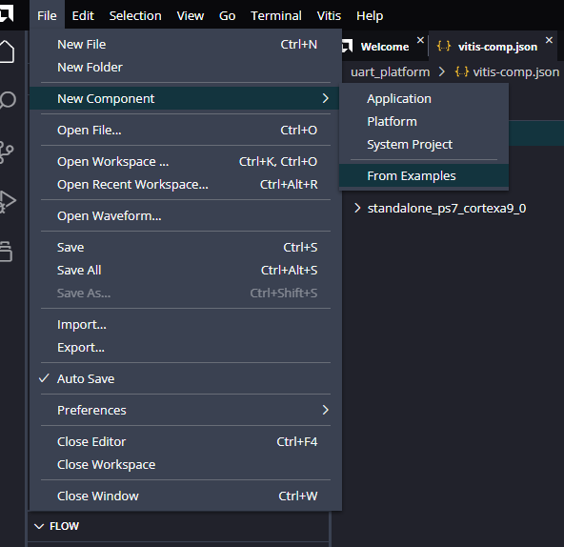
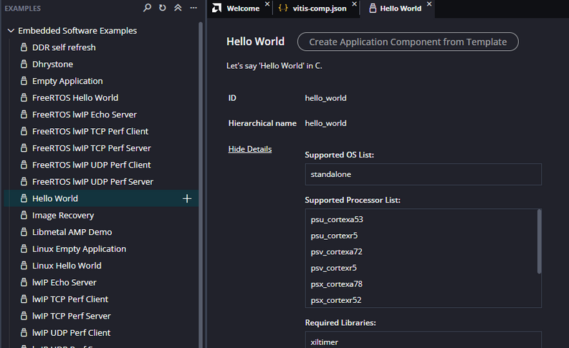
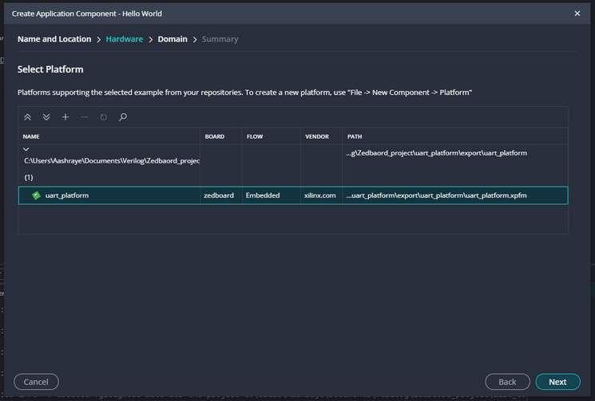
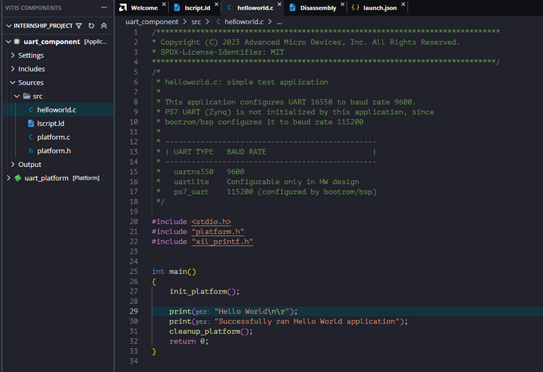
Application Project and UART Code
Now create a new application, from the examples.
Choose Hello World from the examples and press the plus button to create a new application.
Choose the newly created platform for it.

Slide 27
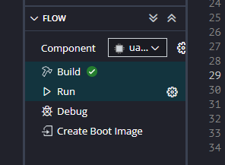
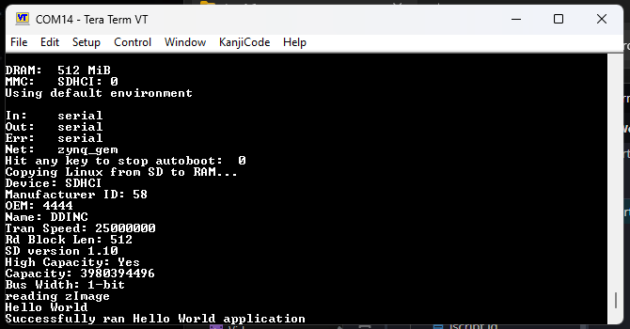
Programming, Debugging, and Testing
Build (compile) the application project in Vitis, producing the required binary files.
Program the ZedBoard by pressing the run button and choose Zedbaord as a target connection.
Use a serial terminal on your PC (such as PuTTY or Tera Term) to connect to the ZedBoard’s UART port, setting the correct baud rate (typically 115200, 8-N-1).
Observe the Hello World output to verify that the UART and application are functioning as expected.

Slide 28
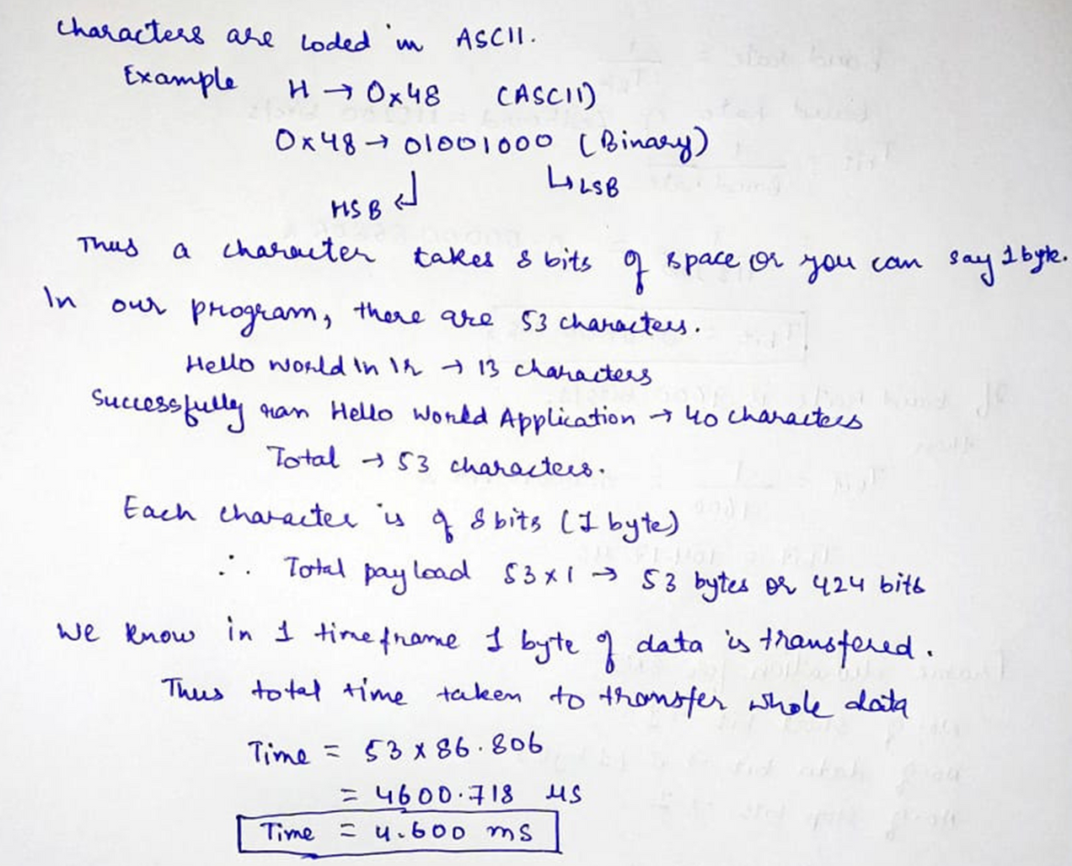
UART
Universal Asynchronous Receiver/Transmitter
Calculations

Slide 29
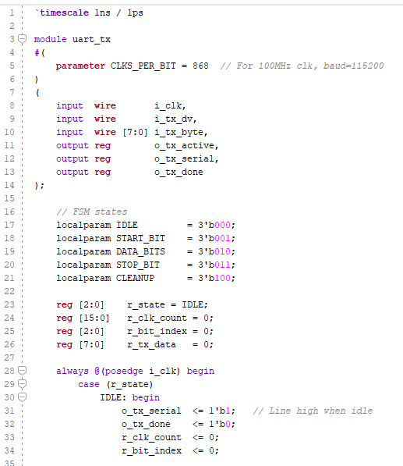
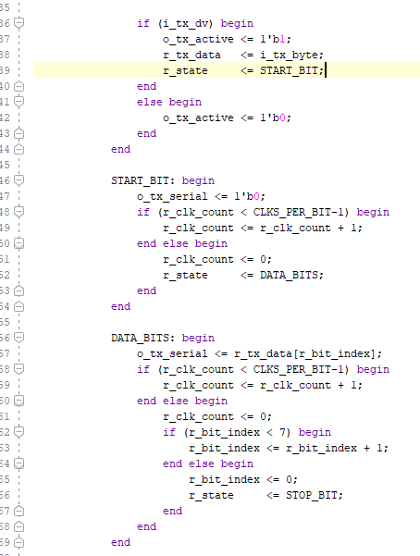
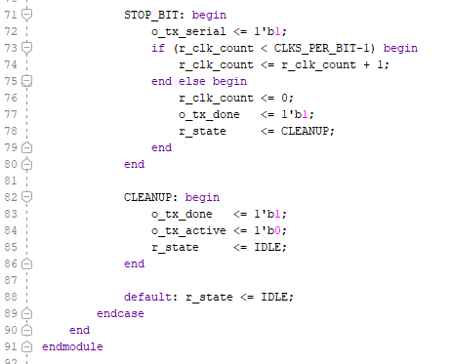
UART Verification using Verilog
Verilog code for Transmitter

Slide 30
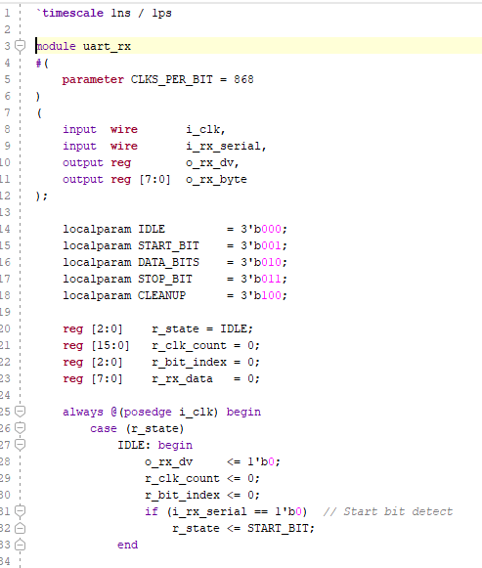
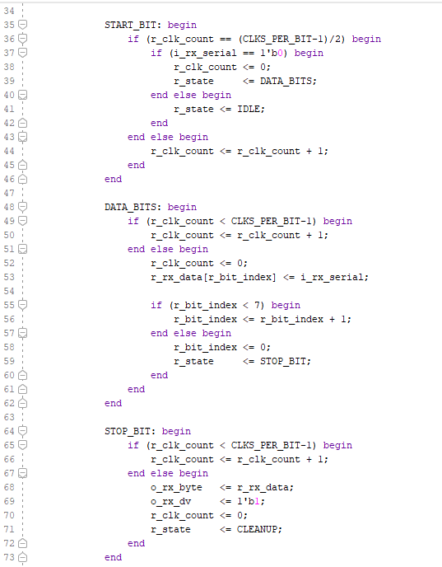
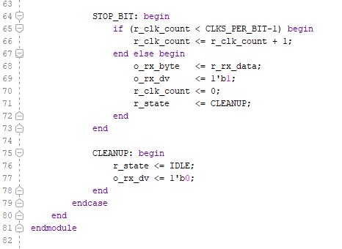
UART Verification using Verilog
Verilog code for Receiver

Slide 31
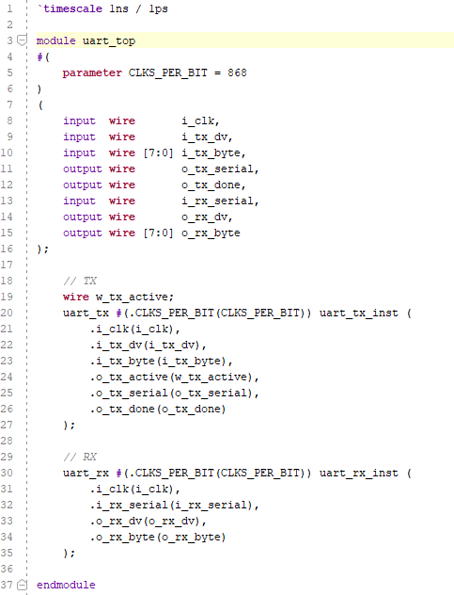
UART Verification using Verilog
Verilog code for Combination of Transmitter and Receiver

Slide 32
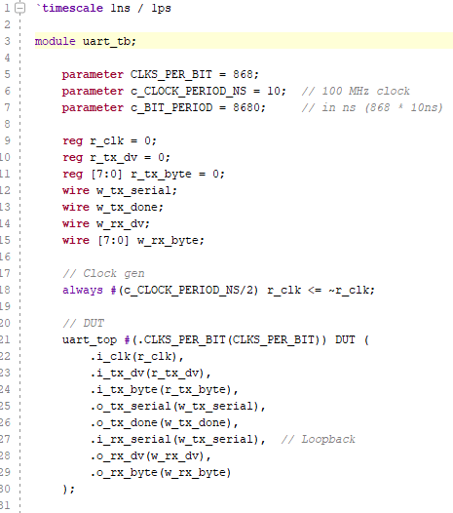
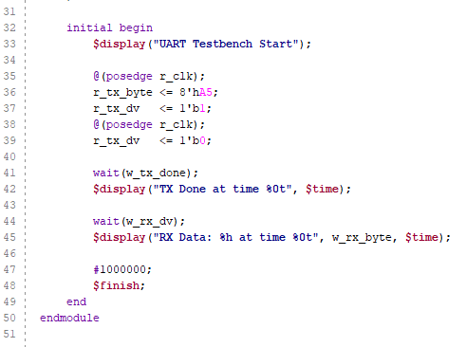
UART Verification using Verilog
Verilog code for Test Bench

Slide 33
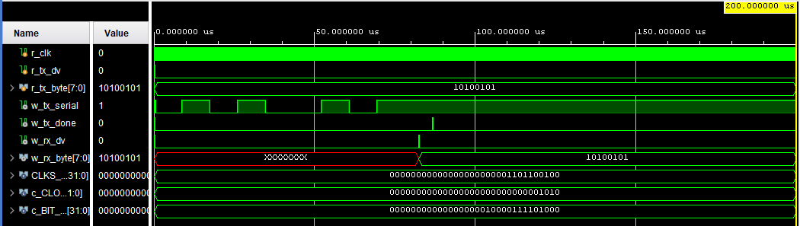
UART Verification using Verilog
Simulation Results

Slide 34
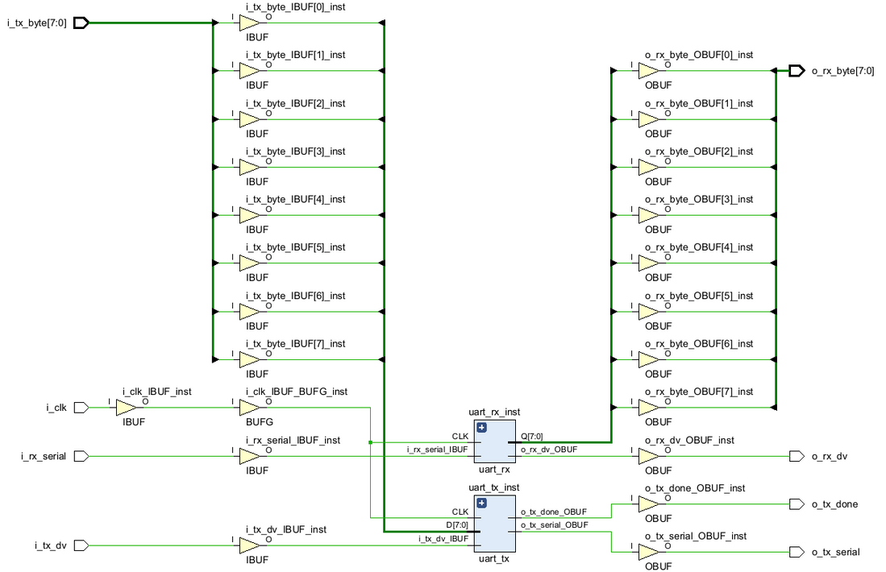
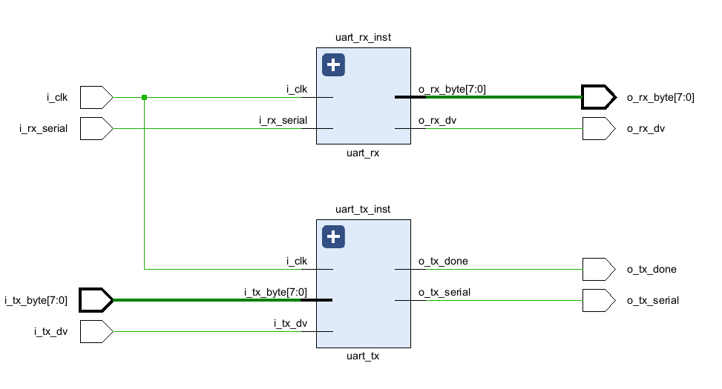
UART Verification using Verilog
Schematics

Slide 35
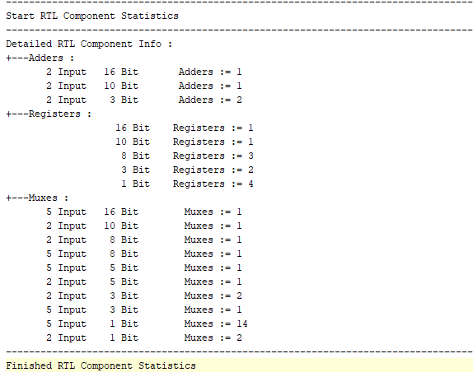
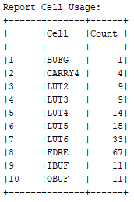
UART Verification using Verilog
Synthesis Report

Slide 36
References
Zedboard Datasheet- https://digilent.com/reference/_media/zedboard:zedboard_ug.pdf
https://www.avnet.com/wcm/connect/a43adf00-158c-4614-b2c7-4a7f35b53f25/FY23_800_ZedBoard_Product_Brief_r2.pdf?MOD=AJPERES&CACHEID=ROOTWORKSPACE-a43adf00-158c-4614-b2c7-4a7f35b53f25-oj5IUo.
Cypress USB-to-UART Setup Guide- https://www.avnet.com/wcm/connect/b7345fea-2f9a-4f5e-b3cd-fac91fe4bf90/CY7C64225_Setup_Guide_1_3-1.pdf?MOD=AJPERES&CACHEID=ROOTWORKSPACE-b7345fea-2f9a-4f5e-b3cd-fac91fe4bf90-nxyWKSk
All guides- https://www.avnet.com/americas/products/avnet-boards/avnet-board-families/zedboard/
UART- https://share.google/LQdF4NHunEGX0rwOC

Slide 37
Thank you

